Slide 1



Electronic Redemptions Processing
Presented by
Haydeliz High
Accounting Specialist
Highlands County Tax Collector

Slide 2


overview
“Old School” Redemptions Process
“Waves of Changes” in Redemptions Processing
Riding a new “Wave” in a completely Electronic Redemptions Process
County Held Tax Certificates
Issuing Electronic Form 1099’s and Form 1042’s
Notes:
Highlands county we have been able to automate our certificate redemptions process to the point of making it completely electronic in nature. With this presentation I hope to show you how we have been able to accomplish this change and hopefully share with you ideas that you can take with you to possibly implement in your office.
Overview of what I will cover
Caution! This is where I warn you that I have added a few test questions to make sure you don’t fall asleep during my exciting discussion on redemptions. So remember to take notes as you will be graded. Actually what I have done is thrown in a few trivia questions that I hope will be fun for you and I have some chocolate to pass around for those that participate. My goal is to make the presentation informative and lively for the time we have, so I hope that you as the audience will humor me and jump right in on the trivia when we get there.

Slide 3

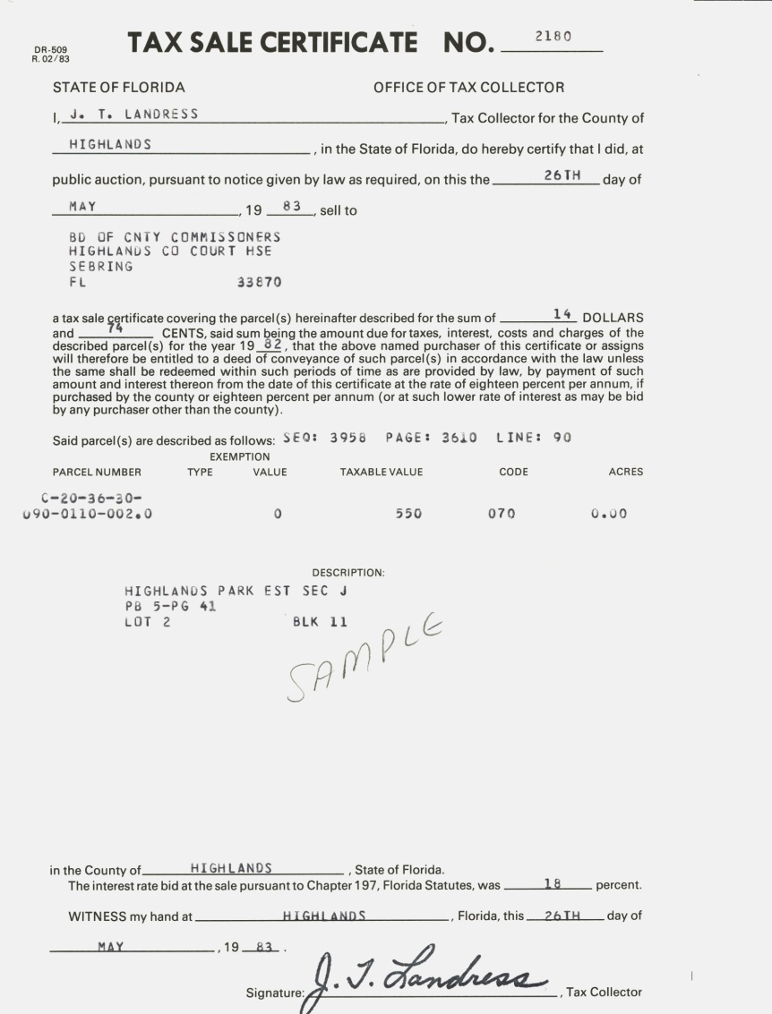

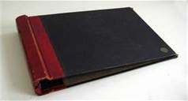


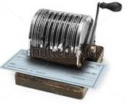
“Old School” Redemptions Process
Delinquent Taxes Paid
Certificates Redeemed
Post to Certificate Book
Print and Mail Redemption Notices
Receive “Tax Sale Certificate” from bidder
Process Payable to bidder

Slide 4

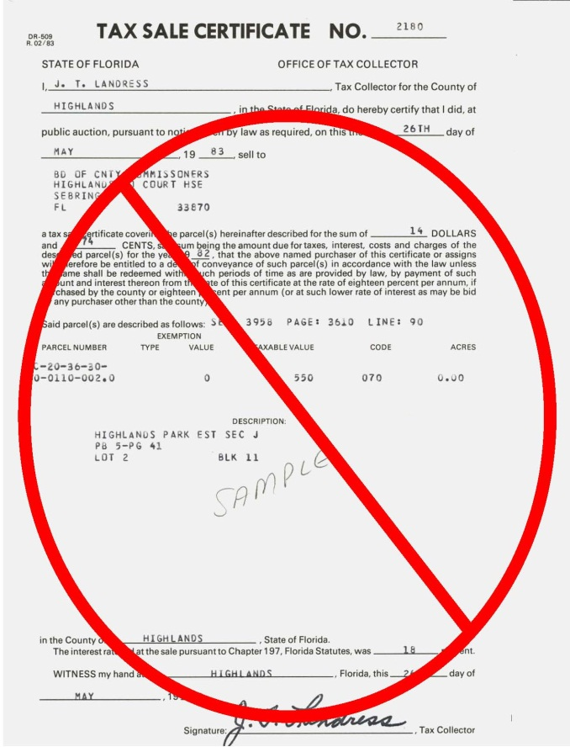
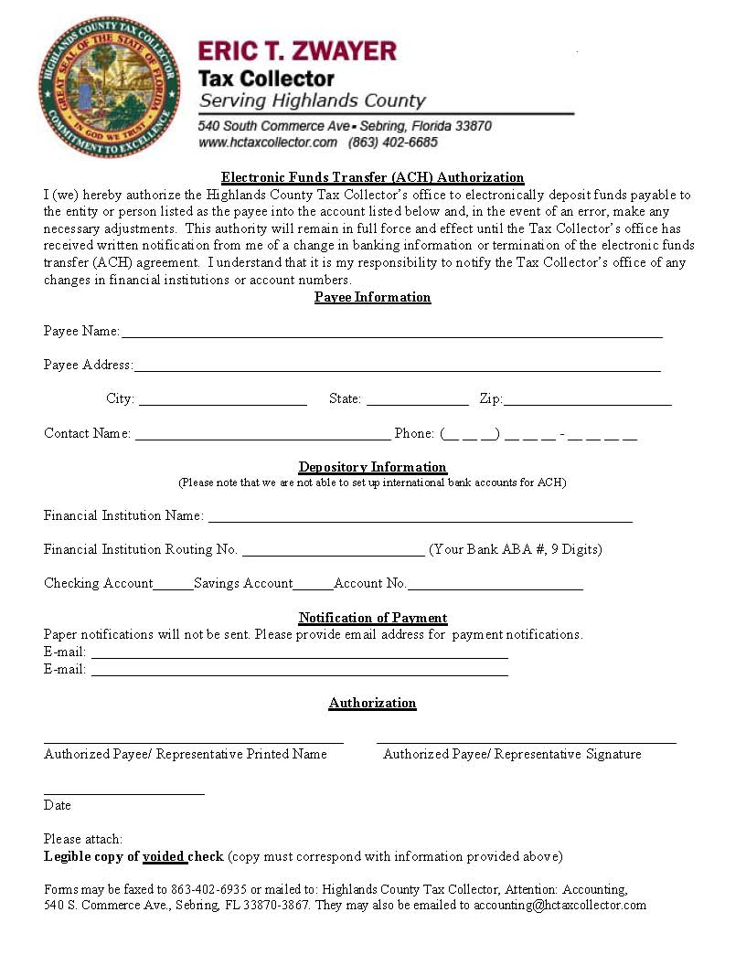

“Waves of Changes” in Redemptions Processing
No longer required Tax Certificate be in paper form
Online Auctions in 2006
New payment options – ACH
Moving towards a cost effective process
Bidders required to sign up for ACH ( some hold outs in beginning)
Still mailed notices

Slide 5
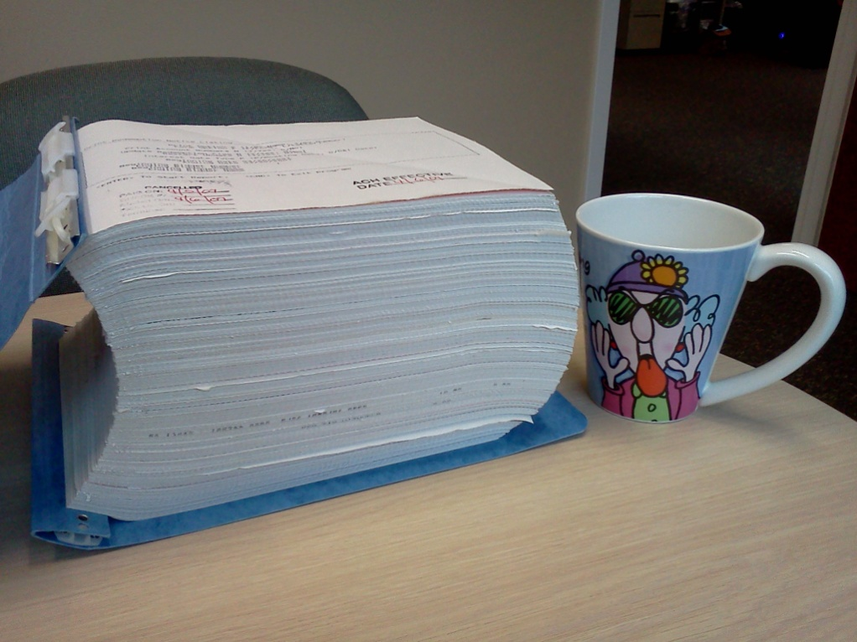

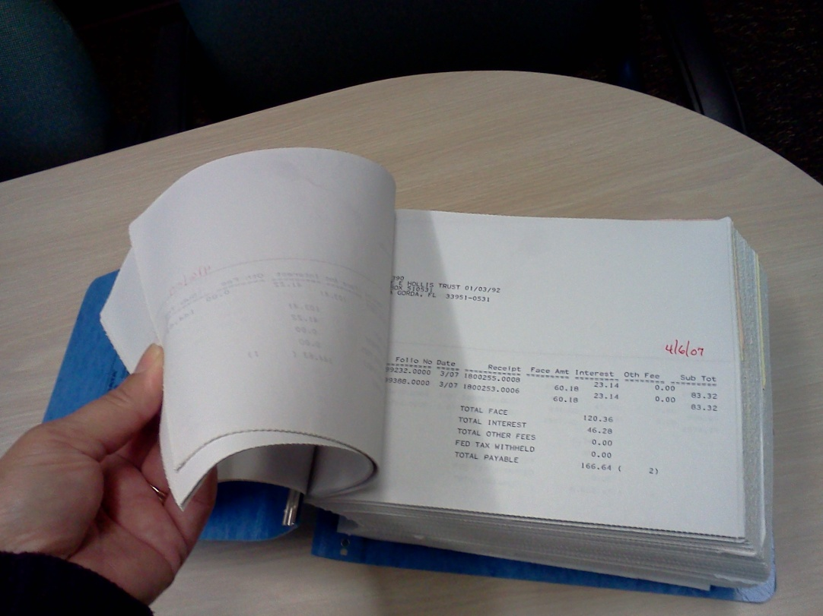

Slide 6



Riding a new “Wave” in a completely Electronic Redemptions Process
Some years later…
Email addresses collected through auction website
Idea: Send redemption notices by email!
Notify bidders of change by email if available
  Some did not have email on record
  Some returned emails
  Some did not have email at all

Slide 7
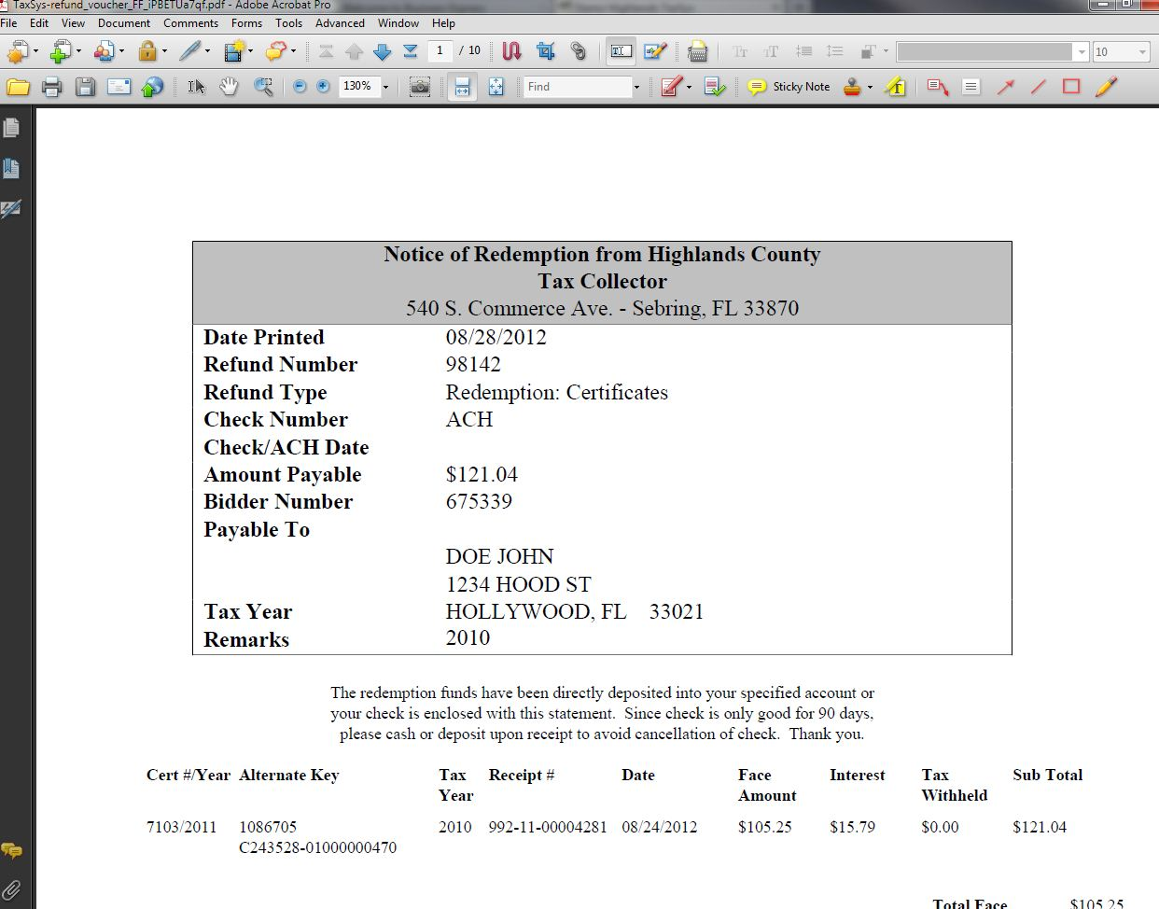


Riding a new “Wave” in a completely Electronic Redemptions Process
Stopped printing redemptions notices!
Generated as PDF then attached to email
One email to bidder with multiple bidder numbers and multiple redemptions
Paperless, but can it get faster?

Slide 8
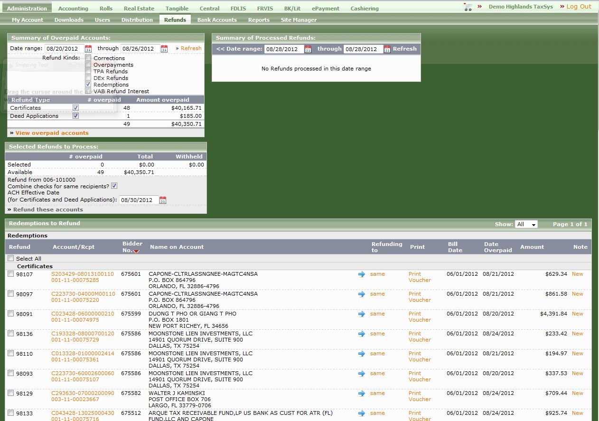
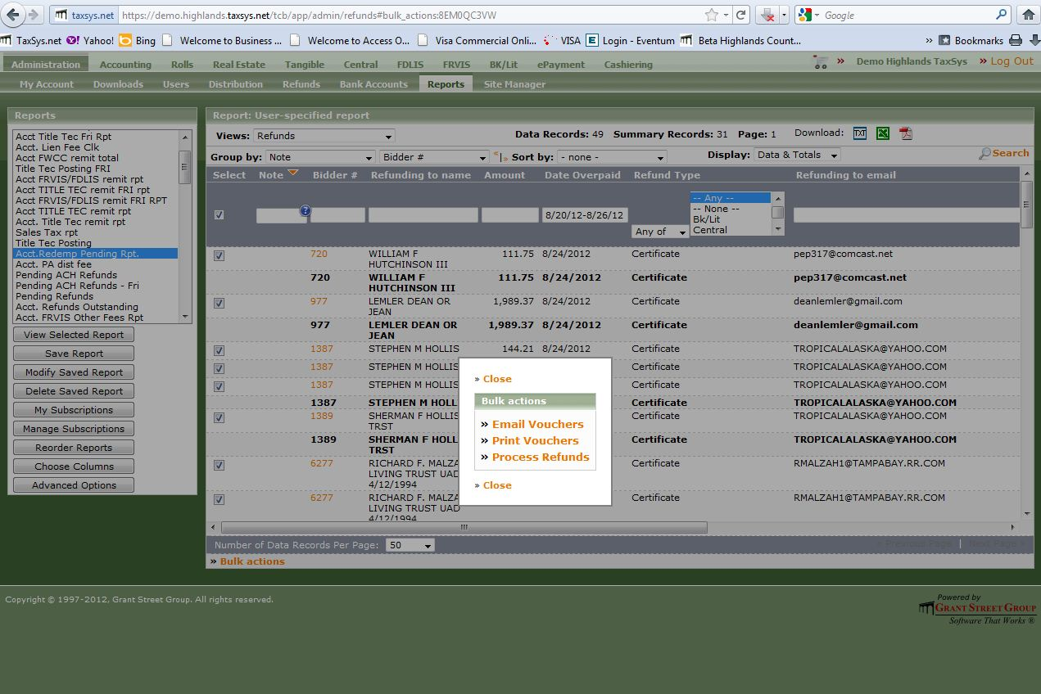
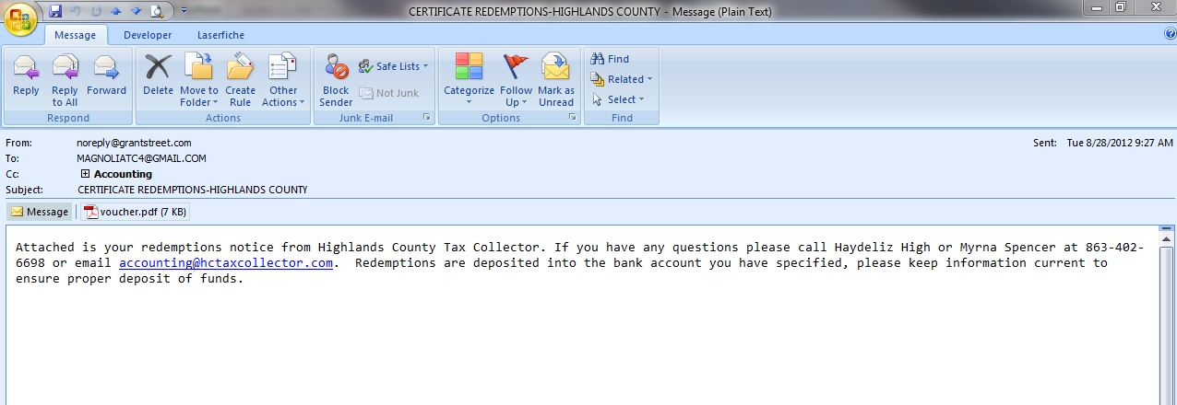
Riding a new “Wave” in a completely Electronic Redemptions Process
What can our programs do for us?
Tax Software helped improve our process
  Added features
Ability to email from within program
  Pro – automated process
  Con – bidder receives multiple emails
Finance program ACH
  Upload payables from tax program
  Better but will be improved – new Finance program and TaxSys changes
Workflow and Data Capture programs
    No manual filing
    Effortless Payables process

Slide 9
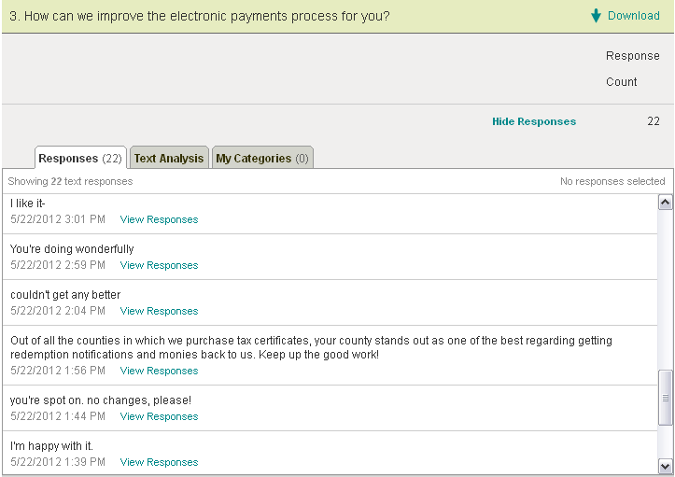
Riding a new “Wave” in a completely Electronic Redemptions Process
Benefits:
  Cost savings – postage, paper, ink, office supplies, and employee time
  Time savings – Shrinking departments, reallocate resources
Certificate Bidder satisfied
  Continues to purchase certificates
  Survey Feedback
Easy access to information in a paperless environment

Slide 10
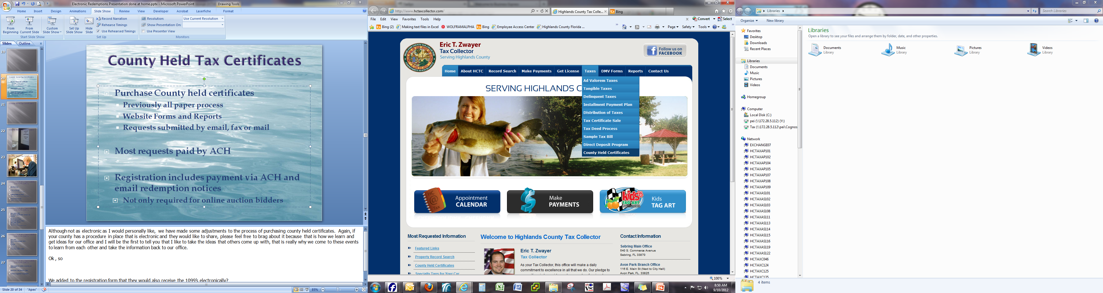
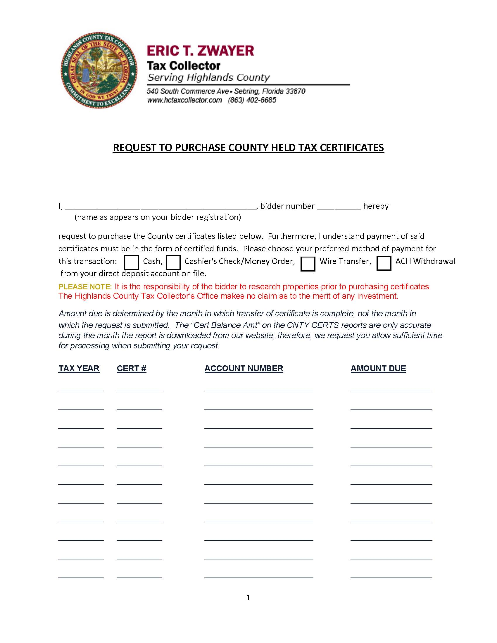
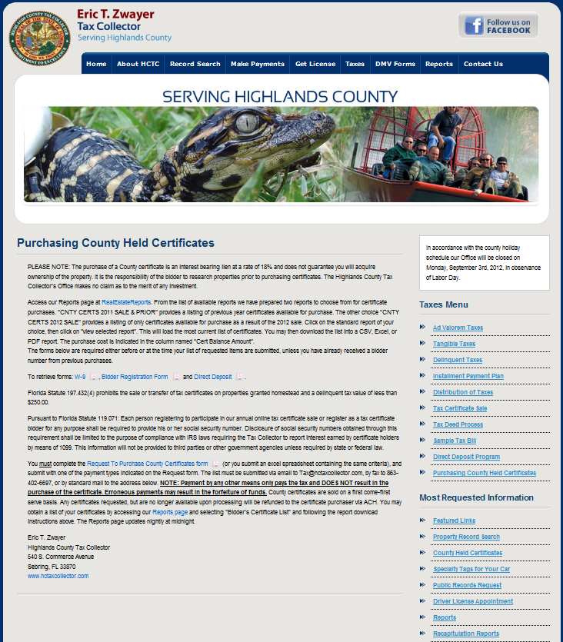
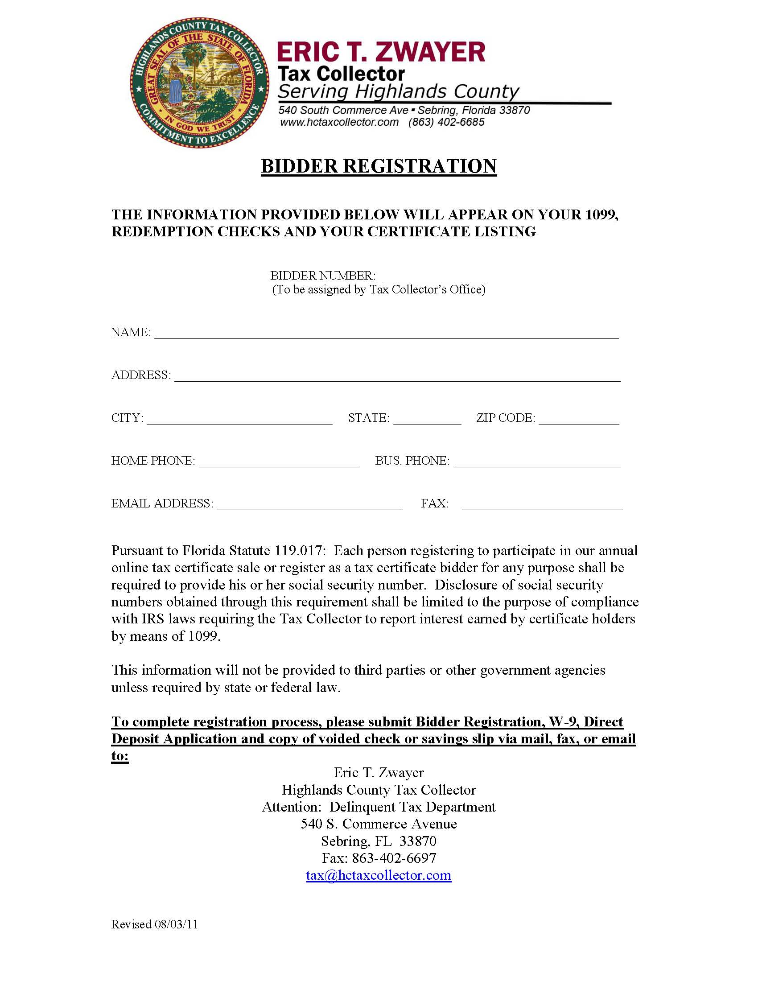
County Held Tax Certificates
Purchase County held certificates
  Previously all paper process
  Website Forms and Reports
  Requests submitted by email, fax or mail
Most requests paid by ACH
Registration includes payment via ACH and email redemption notices
  Not only required for online auction bidders

Slide 11
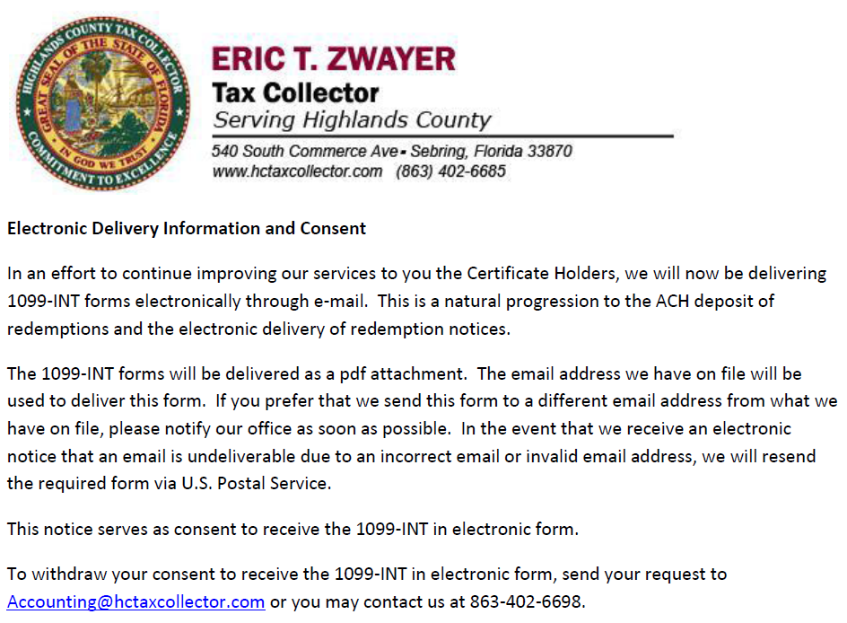
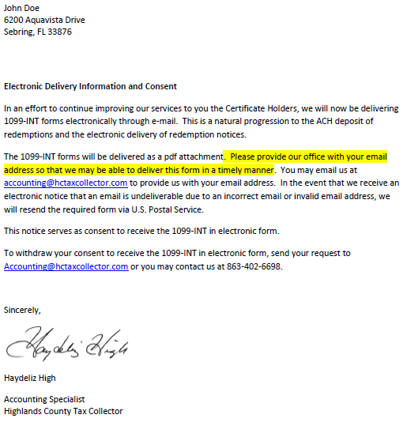
Issuing Electronic Form 1099’s and Form 1042’s
2011 First Year
  Compliment to our electronic redemptions process
Notified Bidders by email
  Gave them option to receive paper form
Bounced back emails in initial setup
  Efforts to update email by phone
  Sent letter by mail

Slide 12
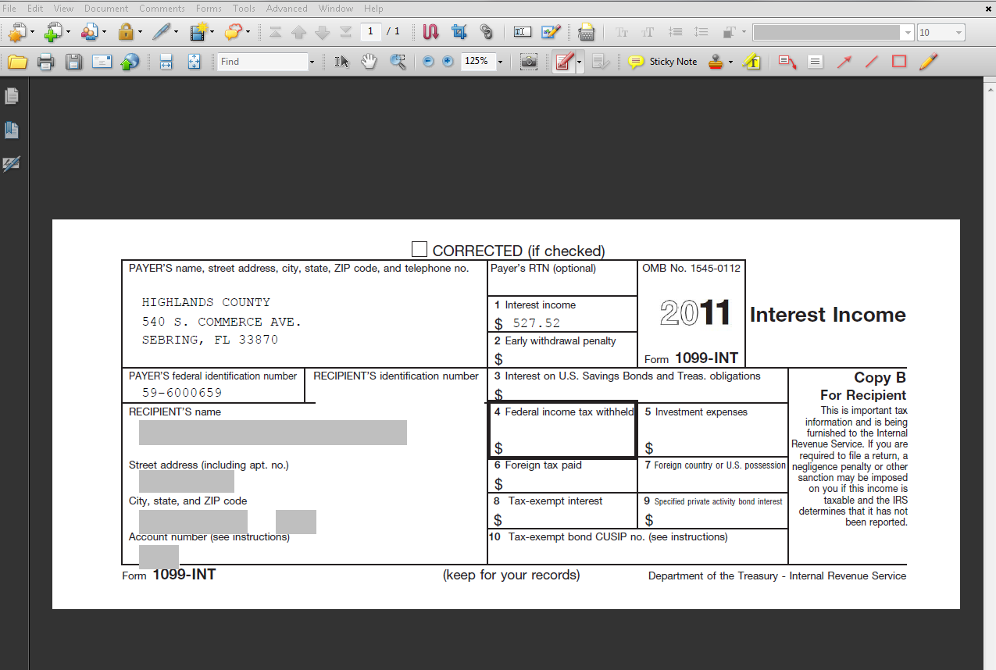
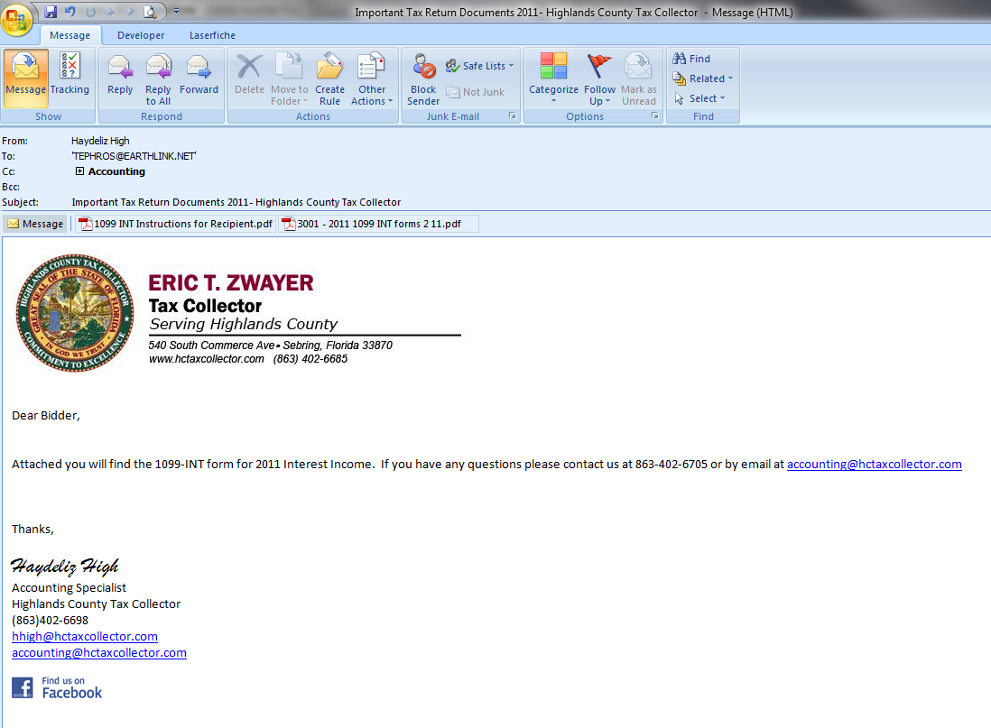
Issuing Electronic Form 1099’s and Form 1042’s
Form 1099 in PDF
Recipient’s Identification Number was secured
  Print to see number
Emails sent manually
Optional programs available for purchase
  We opted to do it in house

Slide 13
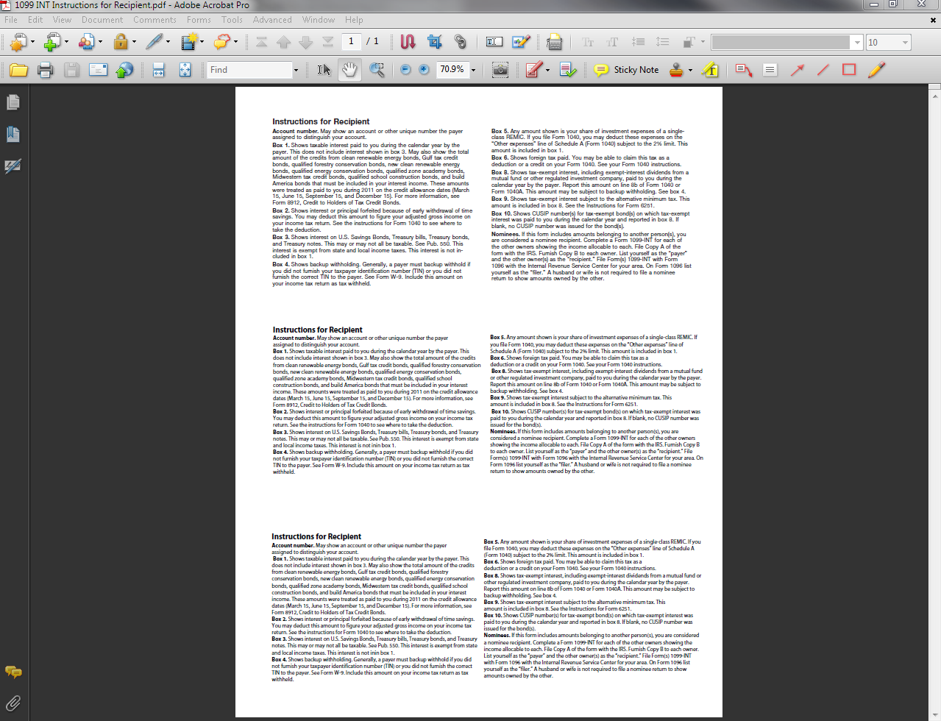
Issuing Electronic Form 1099’s and Form 1042’s
Preparation before January
Sent 15 paper Forms
  Bidder requests – 2
  Undeliverable/ No emails – 12
  No forms ordered
  Preprinted “Instructions for Recipient”
Sent 125 emails
  Combined multiple bidders in one
  Total 259 1099’s issued

Slide 14
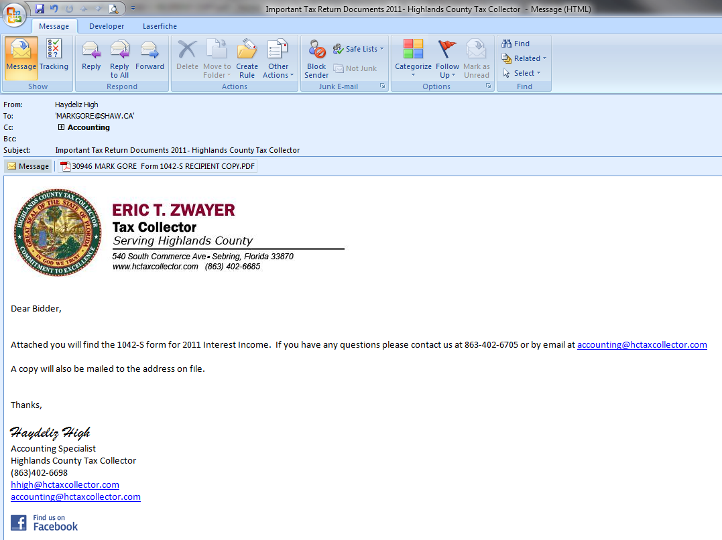
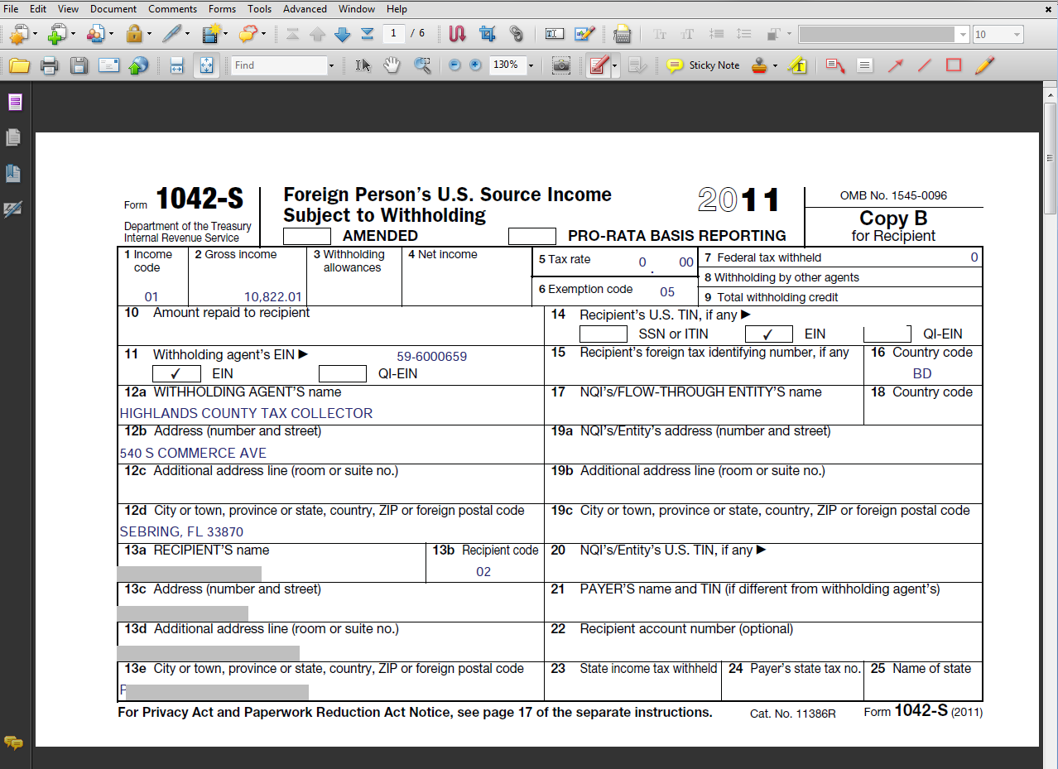
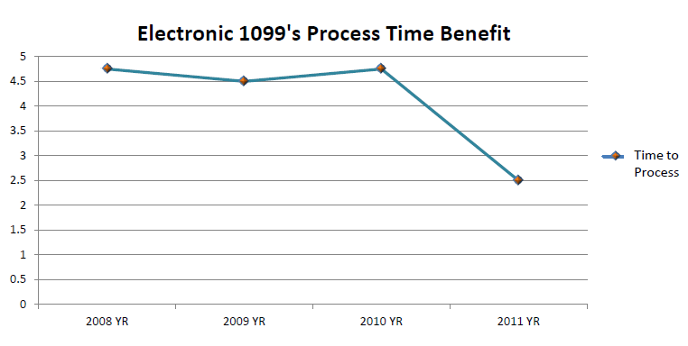
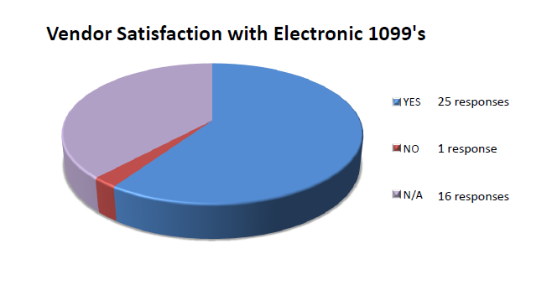
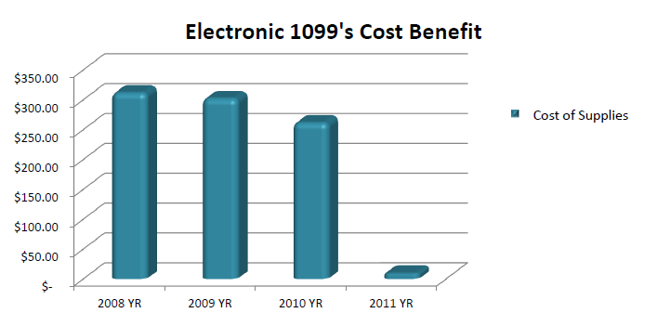
Issuing Electronic Form 1099’s and Form 1042’s
Form 1042
Sent in email and paper form
Sent 4 Forms
  3 Emails sent
Benefits:
  Cost Savings
  TimeSavings
  Bidder Satisfaction
What do our bidders think?
73.5 % Satisfaction

Slide 15

Issuing Electronic Form 1099’s and Form 1042’s
What we learned?
  Improvements are always needed
  New programs may help streamline
  Will continue to offer in this format
  Determination to continue improving our processes
Open to new and innovative ideas
Welcome questions and suggestions

Slide 16

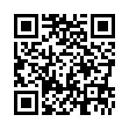
Thank You!
Please remember to fill out your survey for this session at http://www.surveymonkey.com/s/CK7JB23
Or scan the QR code:
Contact Information:
Haydeliz High
Accounting Specialist
hhigh@hctaxcollector.com
863-402-6698

